Slide 1
Software Architecture
Quality Attributes

Slide 2
Good or Bad?
Measurable criterions required...

Slide 3
What does “good” mean?
Question: Is this little C program an example of good or bad software?
Exercise 1: Argue that this is a good program!
Exercise 2: Argue that this is a bad program !
int a[1817];main(z,p,q,r){for(p=80;q+p-80;p-=2*a[p])for(z=9;z--;)q=3&(r=time(0) +r*57)/7,q=q?q-1?q-2?1-p%79?-1:0:p%79-77?1:0:p<1659?79:0:p>158?-79:0,q?!a[p+q*2 ]?a[p+=a[p+=q]=q]=q:0:0;for(;q++-1817;)printf(q%79?"%c":"%c\n"," #"[!a[q-1]]);}
Henrik Bærbak Christensen

Slide 4
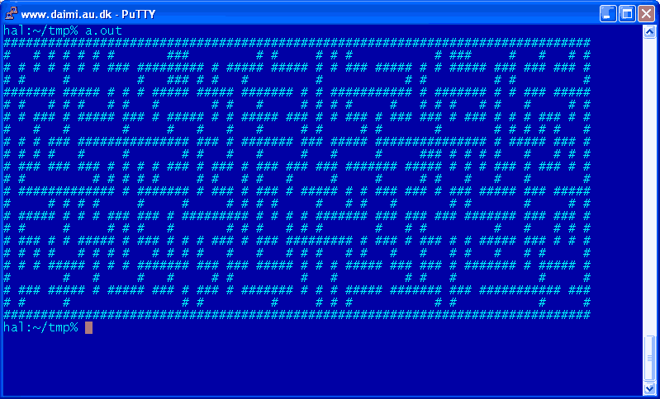
(What did the C program do?)
Henrik Bærbak Christensen

Slide 5
The need for measuring
The server should be highly available...
My software is really reusable!
Our high performance server will...
These are simply claims ☺
Actual measurements on well defined scale is better...
Henrik Bærbak Christensen

Slide 6
Quality Attributes
The problem about ”good” or ”bad” is that they are subjective measures...
We need to measure our software. This requires
  that we define the aspects/qualities we measure
  that we agree on some kind of scale: a metric
Quality attributes (da: kvalitets-attributter)
Henrik Bærbak Christensen

Slide 7
Measuring quality
Quality Framework
Quality Attribute
Metric
Performance
Measurement
Usability
Choose alternatives
Maintainability
Henrik Bærbak Christensen
Notes:
En metrik kan være kvalitativ: høj usability / lav usability; eller kvantitativ: en kassedame vil kunne benytte 80% af systemets funktionalitet efter 2 timers indlæring.

Slide 8
’Quality communities’
One aspects of qualities is that most of them have dedicated research communities associated:
  performance freaks (algorithm people, database, ...)
  usability freaks (HCI – human computer interface )
  security freaks
  cost freaks (managers ☺)
  reusability freaks (pattern community ☺)
...which has lead to lack of common vocabulary…
  user input, attack, event, failures, are all stimulus
We need to provide common ground
Henrik Bærbak Christensen

Slide 9

SAiP’s Contribution
The book Software Architecture in Practice has defined a framework that allow different architecturally qualities to be expressed in a similar form: A quality framework
Quality Attributes: set of qualities to consider
Quality Metric: A technique for measuring them
Henrik Bærbak Christensen
Notes:
before the fact – that is QAS can be used in early architecture design phase – the napkin phase

Slide 10
Quality framework (Bass et al.)
System quality attributes
  Availability
  Modifiability
  Performance
  Security
  Testability
  Usability
Business qualities
  Time to market
  Cost
  Projected lifetime
  Targeted market
  Roll-out schedule
  Integration with legacy sys.
Architectural qualities
  Conceptual integrity
  Correctness and completeness
  Buildability
Henrik Bærbak Christensen

Slide 11
Exercise
System quality attributes
  Availability
  Modifiability
  Performance
  Security
  Testability
  Usability
Business qualities
  Time to market
  Cost
  Projected lifetime
  Targeted market
  Roll-out schedule
  Integration with legacy sys.
Architectural qualities
  Conceptual integrity
  Correctness and completeness
  Buildability
Which of these will have the greatest impact on your professional and personal lives?
Henrik Bærbak Christensen

Slide 12
The System Qualities
Availability
  Concerned with the probability that the system will be operational when needed
Modifiability
  Concerned with the ease with which the system supports change
Performance
  Concerned with how long it takes the system to respond when an event occurs
Henrik Bærbak Christensen

Slide 13
The System Qualities
Security
  Concerned with the systems ability to withstand attacks/threats
Testability
  Concerned with the ease with which the software can be made to demonstrate its faults
Usability
  Concerned with how easy it is for the user to accomplish a desired task and the kind of user support the system provides
Henrik Bærbak Christensen

Slide 14
“We want them all”
Qualities in conflict

Slide 15
The conflict of qualities
Many qualities are in direct conflict – they must be balanced !
  modifiability and performance
    many delegations costs in execution speed – and memory footprint
  cost and reusability
    highly flexible software costs time, effort, and money
  security and availability
    availability through redundancy – increase opportunities of attack
  etc.
Henrik Bærbak Christensen

Slide 16
Design Patterns in Perspective
Examples of Good turning Bad

Slide 17
Iteration
In a distributed system, the clients need to iterate over all order lines in a order object...
Using RMI – Remote Method Invocation – the code looks exactly the same even when the Order object is on the server side !!! Great!
Iterator is a nice, flexible, design pattern ☺
Iterator i = order.iterator();
while ( i.hasNext() ) {
OrderLine entry = (OrderLine) i.next();
[process entry]
}
Henrik Bærbak Christensen

Slide 18
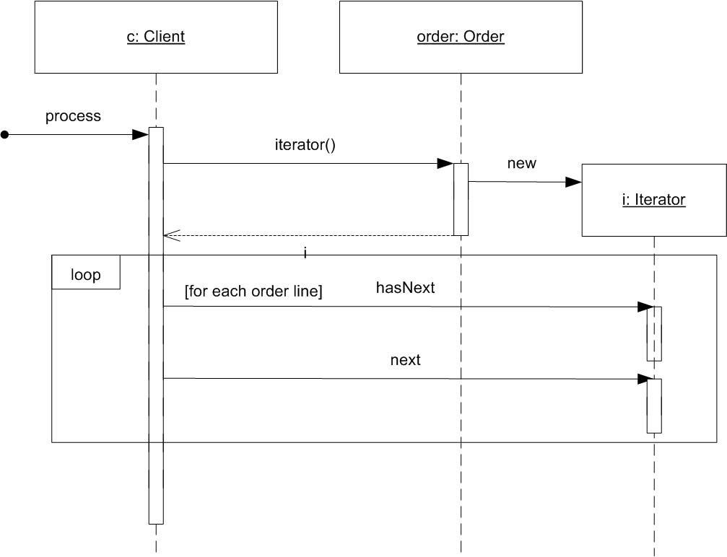
The sequence diagram
All is fine ...
Henrik Bærbak Christensen

Slide 19
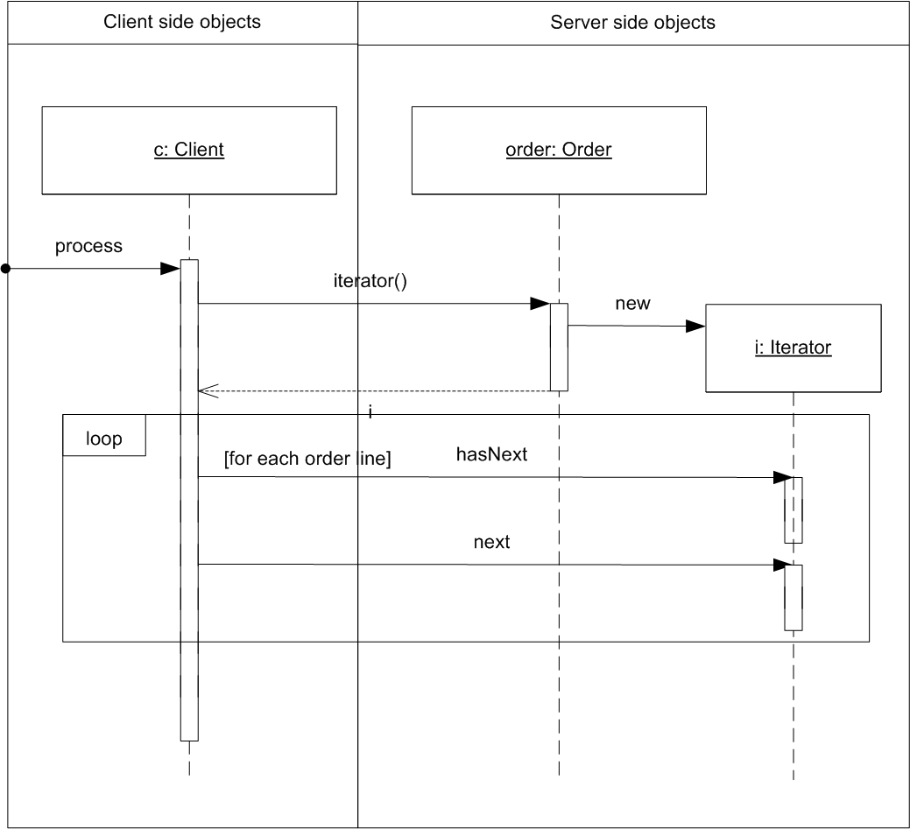
... but
Let us consider the deployment of objects
Henrik Bærbak Christensen

Slide 20
... what about performance ?
Message-call is much more expensive over a network
  2002 data: 20.000 msg/sec local; 220 msg/sec remote
  90-times slow-down – probably even worse today.
The iterator pattern ensures an extreme slow-down compared to transfering all order line objects in a single network package !
Henrik Bærbak Christensen

Slide 21
Another example...
Singleton
  Ensure a class only has one instance, and provide a global point of access to it.
However, a singleton in a distributed system is a major headache!
  one server becomes two servers with a load balancer for scalability
    now there are two singletons !
  really only one singleton
    a major performance bottle-neck to ensure the system will never ever scale !
Actually – many consider singleton an anti-pattern!
Henrik Bærbak Christensen

Slide 22
Maintainability in Details
A key quality in design patterns, frameworks, and compositional designs...
(Repeating a previous slides show ☺)
Henrik Bærbak Christensen

Slide 23
The Bass Framework
The Bass framework is rather coarse grained.
Another, much more detailed, framework is the ISO 9126 standard.
In particular it restate most qualities into sub qualities.
Henrik Bærbak Christensen

Slide 24
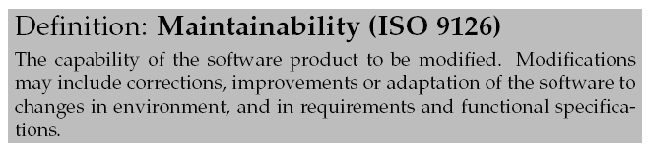
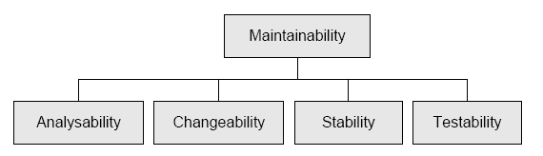
Sub Qualities of Maintainability
Compare: cost of ease of change (Bass et al.)
Henrik Bærbak Christensen

Slide 25
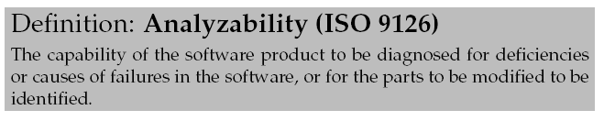
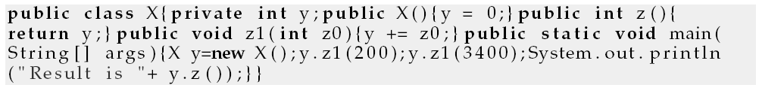
Analyzability
Examples:
  The Account program
Henrik Bærbak Christensen

Slide 26
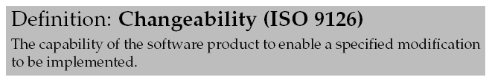
Changeability
Examples
  The size of the Maze program is only present in terms of magic numbers
  Consider using constants like MAZE_WIDTH instead
  Delegation based techniques to encapsulate variability
Henrik Bærbak Christensen

Slide 27
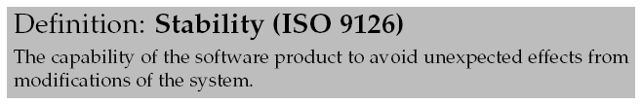
Stability
War story
  Person ID in ABC
    ID = RFID tag; used by inference engine to detect ”activities”
    Later a student programmer changed it CPR
      Nothing worked during a demo for the physicians ☹
Henrik Bærbak Christensen

Slide 28

Testability
Examples
  The GammaTown pay station rate strategy
  ... And lots of others
Henrik Bærbak Christensen

Slide 29
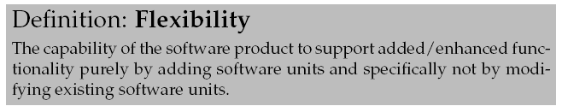
Flexibility
Note: Not an ISO definition, but my own ☺
Examples
  Almost everything in my book ...
Henrik Bærbak Christensen

Slide 30
Summary
Architectural Qualities: Maintainability is just one of several qualities of a software system
  Qualities often are in conflict
  Software architect must find the proper balance between them
  Maintainability (= techniques from this course) are not necessarily a primary driver!
Maintainability
  Has sub qualities
    Stability, changeability, testability, analyzability
  Flexiblity: change by addition, not by modification...
Henrik Bærbak Christensen

Slide 31
Summary
There is no good or bad software!
  There is software that measure differently on the different qualities
    Fast but difficult to change
    Maintainable but performs less
    Etc.
OK, OK: Software that is not maintainable, performs lousy, is in-secure, unreliable… is bad software…
Henrik Bærbak Christensen

